Slide 1
STRESS IN THE WORKPLACE
Helpful, Healthy Ways to Manage Stress
Presented by: Dr. Brian K. Becker

Slide 2
Where Does Stress Come From?
Physical
Chemical
Emotional
Subluxation*
Lack of movement
Trauma
Rep motion
Lack of Stretching
Degeneration
Poor Intake
Toxic
Deficient
Simple Sugar
Trans fats
Lack of Balance
Chronic Stress
Anger
Fear
Resentment
Uninformed
Lack of purpose Unbalanced perceptions
(*Subluxation – A misalignment of the spine)

Slide 3
What is the Body’s Stress Response?
You expose yourself and your cells to a Stressor
Your nervous system and brain activate the stress response
Increased levels of Stress Hormones
(affects the genetic expression of all cells)
Emergency Breakdown of Entire Body
Result:
Chronic Diseases and Illness

Slide 4
Chronic Stress Increases…
Cortisol
Catecholamines
heart rate
Vasoconstriction
Blood pressure
Blood glucose levels (by insulin receptors being down regulated)
Insulin resistance (Type 2)
More sympathetic response
Blood lipid levels
Blood cholesterol levels (increase LDL, decrease HDL)
Clotting factors
Protein degradation of muscle and connective tissue
Feelings of stress, fear, anxiety and depression, causing bone loss

Slide 5
Chronic Stress Decreases…
Short term memory
Ability to concentrate & learn new material
Serotonin levels (therefore increase in noradrenaline levels)
Cellular immunity (TH1 response; increase TH2-allergy, especially if vaccinated)
Anabolic hormones (i.e. Growth hormones, testosterone, luteinizing hormone)
REM sleep

Slide 6
“According to the New England Journal of Medicine, up to 96% of all diseases are lifestyle related.”

Slide 7
Chronic Stress Body Responses…
Blood pressure/heart disease/cholesterol
Cancer
Type 2 Diabetes
Chronic Fatigue/Fibromyalgia/Syndrome X
Osteoporosis
Depression-downward spiral
Obesity
ADHD
Indigestion
Accelerated aging
Almost every disease is just the body adapting to chronic stress!!

Slide 8
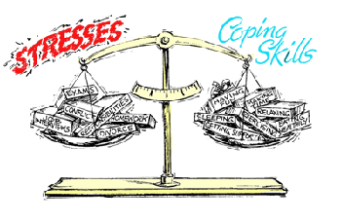
Unhealthy Choices To Cope With Stress
Smoking
Alcohol / drugs
Overeating
Excessive media, TV, computer
Withdrawing

Slide 9
Lifestyle Changes to Decrease Stress

Slide 10
MOVE WELL…
From the moment we are born, there are stresses on the nervous system (spine)
Improper movement, lack of movement, and daily stresses can cause problems with the body
A vertebral subluxation is the result of spinal bones with improper motion or position, affecting nerve communications between your brain and your body. sub = less than | luxation = dislocation.
A vertebral subluxation is a stress response.

Slide 11
What causes subluxations?
Subluxations come from
Lifestyle stress.
Emotional Stress!
Biochemical Stress!
Physical Stress!

Slide 12
Chiropractic… What is it?
Chiropractic is a form of health care
that identifies and corrects problems with the
NERVOUS SYSTEM
to allow the body to
HEAL ITSELF
and achieve
OPTIMUM HEALTH

Slide 13
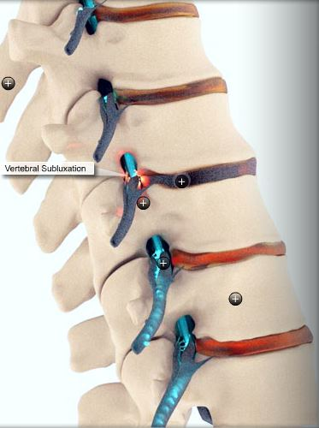
Wellness With Chiropractic…
Chiropractic care is aimed at identifying and addressing the physical, bio-chemical, & emotional causes of subluxation.

Slide 14
THINK WELL…
We Were Born To Be Great!
Are you on your path? If not, why not?
Are we challenging ourselves?
Have we settled?

Slide 15
Learn How To Avoid Stressors
DO THIS…
WITH THIS…
Learn to say “No”…
Avoid people who…
Control your environment…
Avoid gossip…always
Avoid hot button topics…
Reduce your “To Do” list…
…to Family, Work, Volunteerism
…“Stress You Out”
…Who you live with, what you watch (news)
…Religion or Politics
…Simplify

Slide 16
THINK WELL…
Become Your Authentic Self
Our True Nature
The world around us
causes us to manifest
Integrity
Curiosity
Passion
Fearlessness
Love
Faith
Doubt
Uncertainty
Anxiety
Anger
Fear
Scarcity
VS.
6 Deadly Toxins of Your Authentic Self
Complaining, Criticizing, Being negative, Gossiping, Excuse making, Holding onto your story

Slide 17
THINK WELL…
Ways to Reduce Stress
AFFIRMATION
VISUALIZATION
MEDITATION – DEEP BREATHING
GOAL SETTING – DAILY REVIEW
GRATITUDE JOURNALING
CONNECT WITH NATURE (Hike, Walk)
FOCUS ON A HOBBY (Gardening, Fishing)

Slide 18
AFFIRMATION
AFFIRMATION
Use Statements Such As…
“I Am A Wonderful…(fill in the blank)”
“I Am Great At…(fill in the blank)”
“I Am Loving & Kind”
I believe
Relax
release
Write your statements, and say them out loud to yourself, with feeling, twice a day. Repeat for at least 90 days, and you will have a new healthy habit.
Relief
positive
Strength
visualize
Affirm
I can do…
I am loving
Attitude

Slide 19
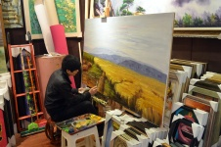
VISUALIZATION
What we see in our mind,
we can become
Visualize in detail in my mind using all five senses

Slide 20
MEDITATION
BENEFITS OF MEDITATION
Experience …
Decrease In Stress
Decrease In Anxiety
Maintain Your Blood Pressure
Maintain Your Heart Rate
Decrease Your Stress Hormones

Slide 21
Goal Setting
“If you aim at nothing, you’ll hit it every time.”
STEP ONE: Make a list of the experiences you want to have
STEP TWO: Make another list of how you need to grow to achieve those experiences
STEP THREE: Make a list of what you can give back to the world
For details on goal setting, check out this cool video:
http://www.stuckychiropractic.com/news/think-well-series-reaching-goals-successfully/

Slide 22
JOURNALING
“Commitment motivates, inspires and guides your journey”
Record daily those things you are grateful for. Grateful and negative emotions can’t live together

Slide 23
EAT WELL…
Questions To Ask Yourself
BE
Do you want more ENERGY?
Do you want to reduce SUGAR cravings?
MORE
Want to achieve / MAINTAIN ideal body weight?
Want to decrease risk of Alzheimer’s, Dementia, Heart Disease, Digestive disorders & ALL OTHER CHRONIC DISEASES?
HEALTHY
Do you want to reduce your risk of CANCER?
Do you want to dramatically SAVE $$$ on health care costs?
Do you want to IMPROVE the health of your FAMILY?

Slide 24
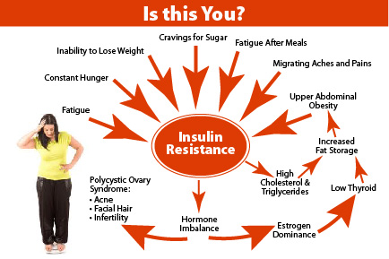
Sugars/carbs & insulin resistance

Slide 25
sweeteners
Best sweeteners to use (sparingly, of course)
Worst sweeteners
Stevia
Monk Fruit
Raw Honey
Real Maple Syrup
Lucama
Fruit
High Fructose Corn Syrup
Corn Syrup
White Sugar
Brown Sugar
Can Syrup
Any Artificial (Equal, Splenda, Nutri-Sweet)

Slide 26
EAT WELL…
Stucky Chiropractic leads classes on the subject matters of Think Well, Eat Well, and Move Well. We are also a local resource for your healthcare and would be happy to help with any questions you have.
Resources:
www.stuckychiropractic.com
www.stuckyweightloss.com
www.marksdailyapple.com
www.drjockers.com
www.mercola.com
www.foodmatters.tv
www.naturalnews.com
www.primalpalate.com
www.paleomg.com
www.spunkycoconut.com

